Slide 1
System Administration: Final Project
By Christopher Penner and Michael Gomez

Slide 2
Introduction

Slide 3
What is Docker?
A way to package software to run on any hardware
It has 3 main parts to it:
Dockerfile
Image
Container

Slide 4
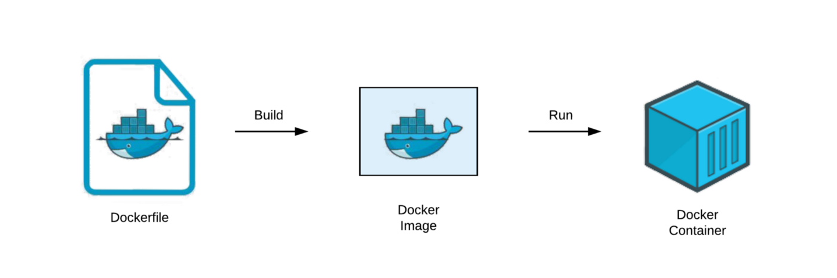
What is Docker?
Dockerfile - a blueprint for the Docker image
Image - template for running Docker containers
Container - template for running Docker containers

Slide 5
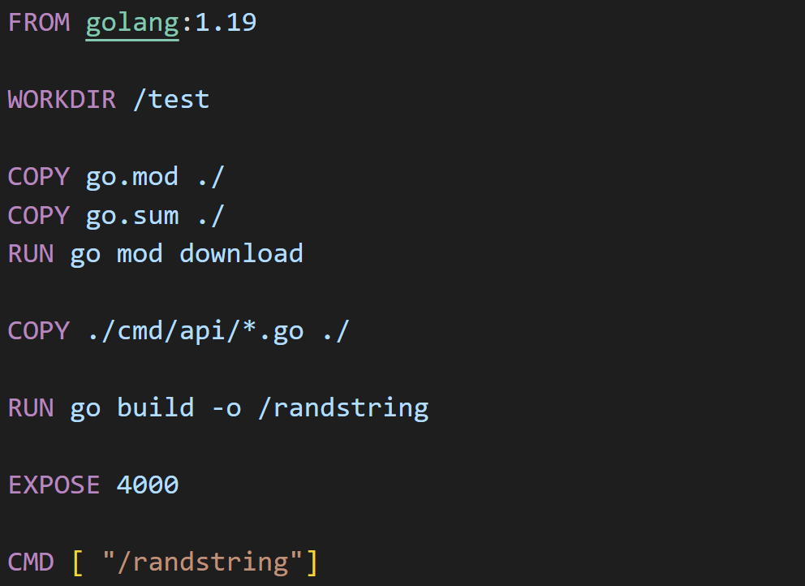
Dockerfile
Example:
Defines the Environment
It builds the docker image with all dependencies and the correct environment version.

Slide 6
Docker Image
Build a Docker Image with:
docker build -t (name) (location)
-t (tag) puts a nametag on the image: (name)
Followed by the path to the dockerfile: (location)

Slide 7
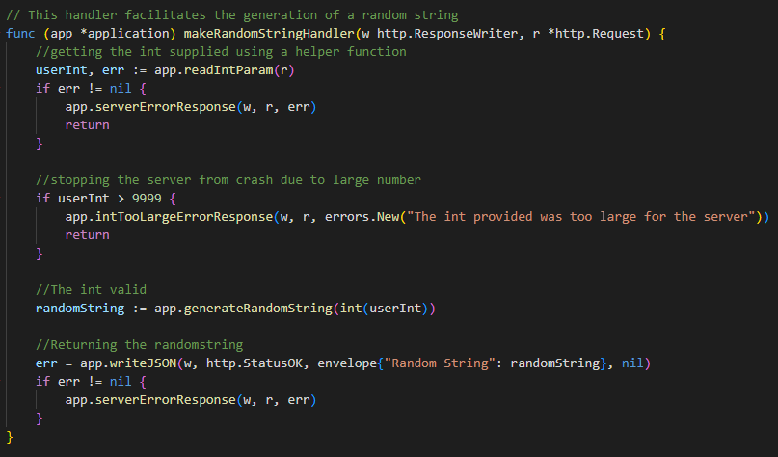

Web Application
Our web application is a simple backend web server that supports only one api call.
Where a random string is generated based on the integer we supply in the api call.
The web app using json to server the information back to the user.

Slide 8
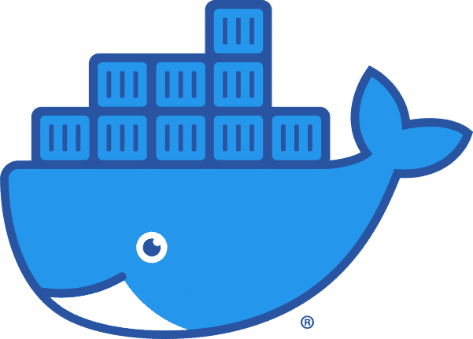

Container Demonstration

Slide 9
Thanks for watching

